Slide 1

DIGNITY UNITES US
Global Dignity Day Celebration
Social Media Toolkit
October 2021

Slide 2
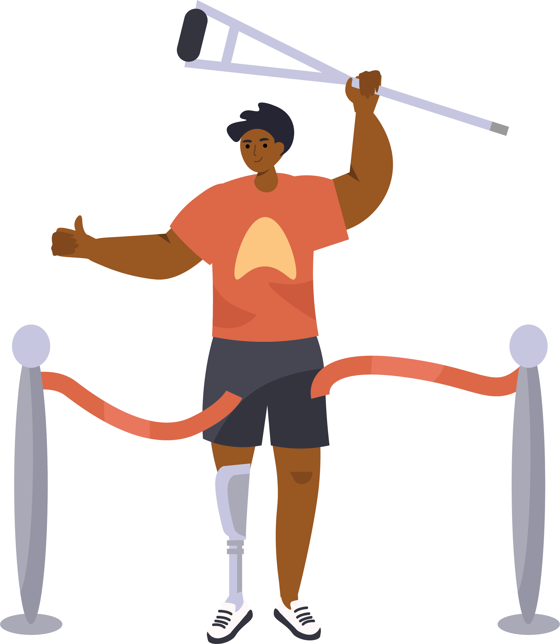
celebrate dignity!
2
This Oct 20th, on Global Dignity Day,
we invite you to…

Slide 3
Table of Contents
3
TABLE OF CONTENTS
1
Who We Are
4
Global Dignity Day
Celebrating With
Dignity Alliance
2
The Need For Dignity
5
3
What Dignity Looks Like
6
Taking Action

Slide 4
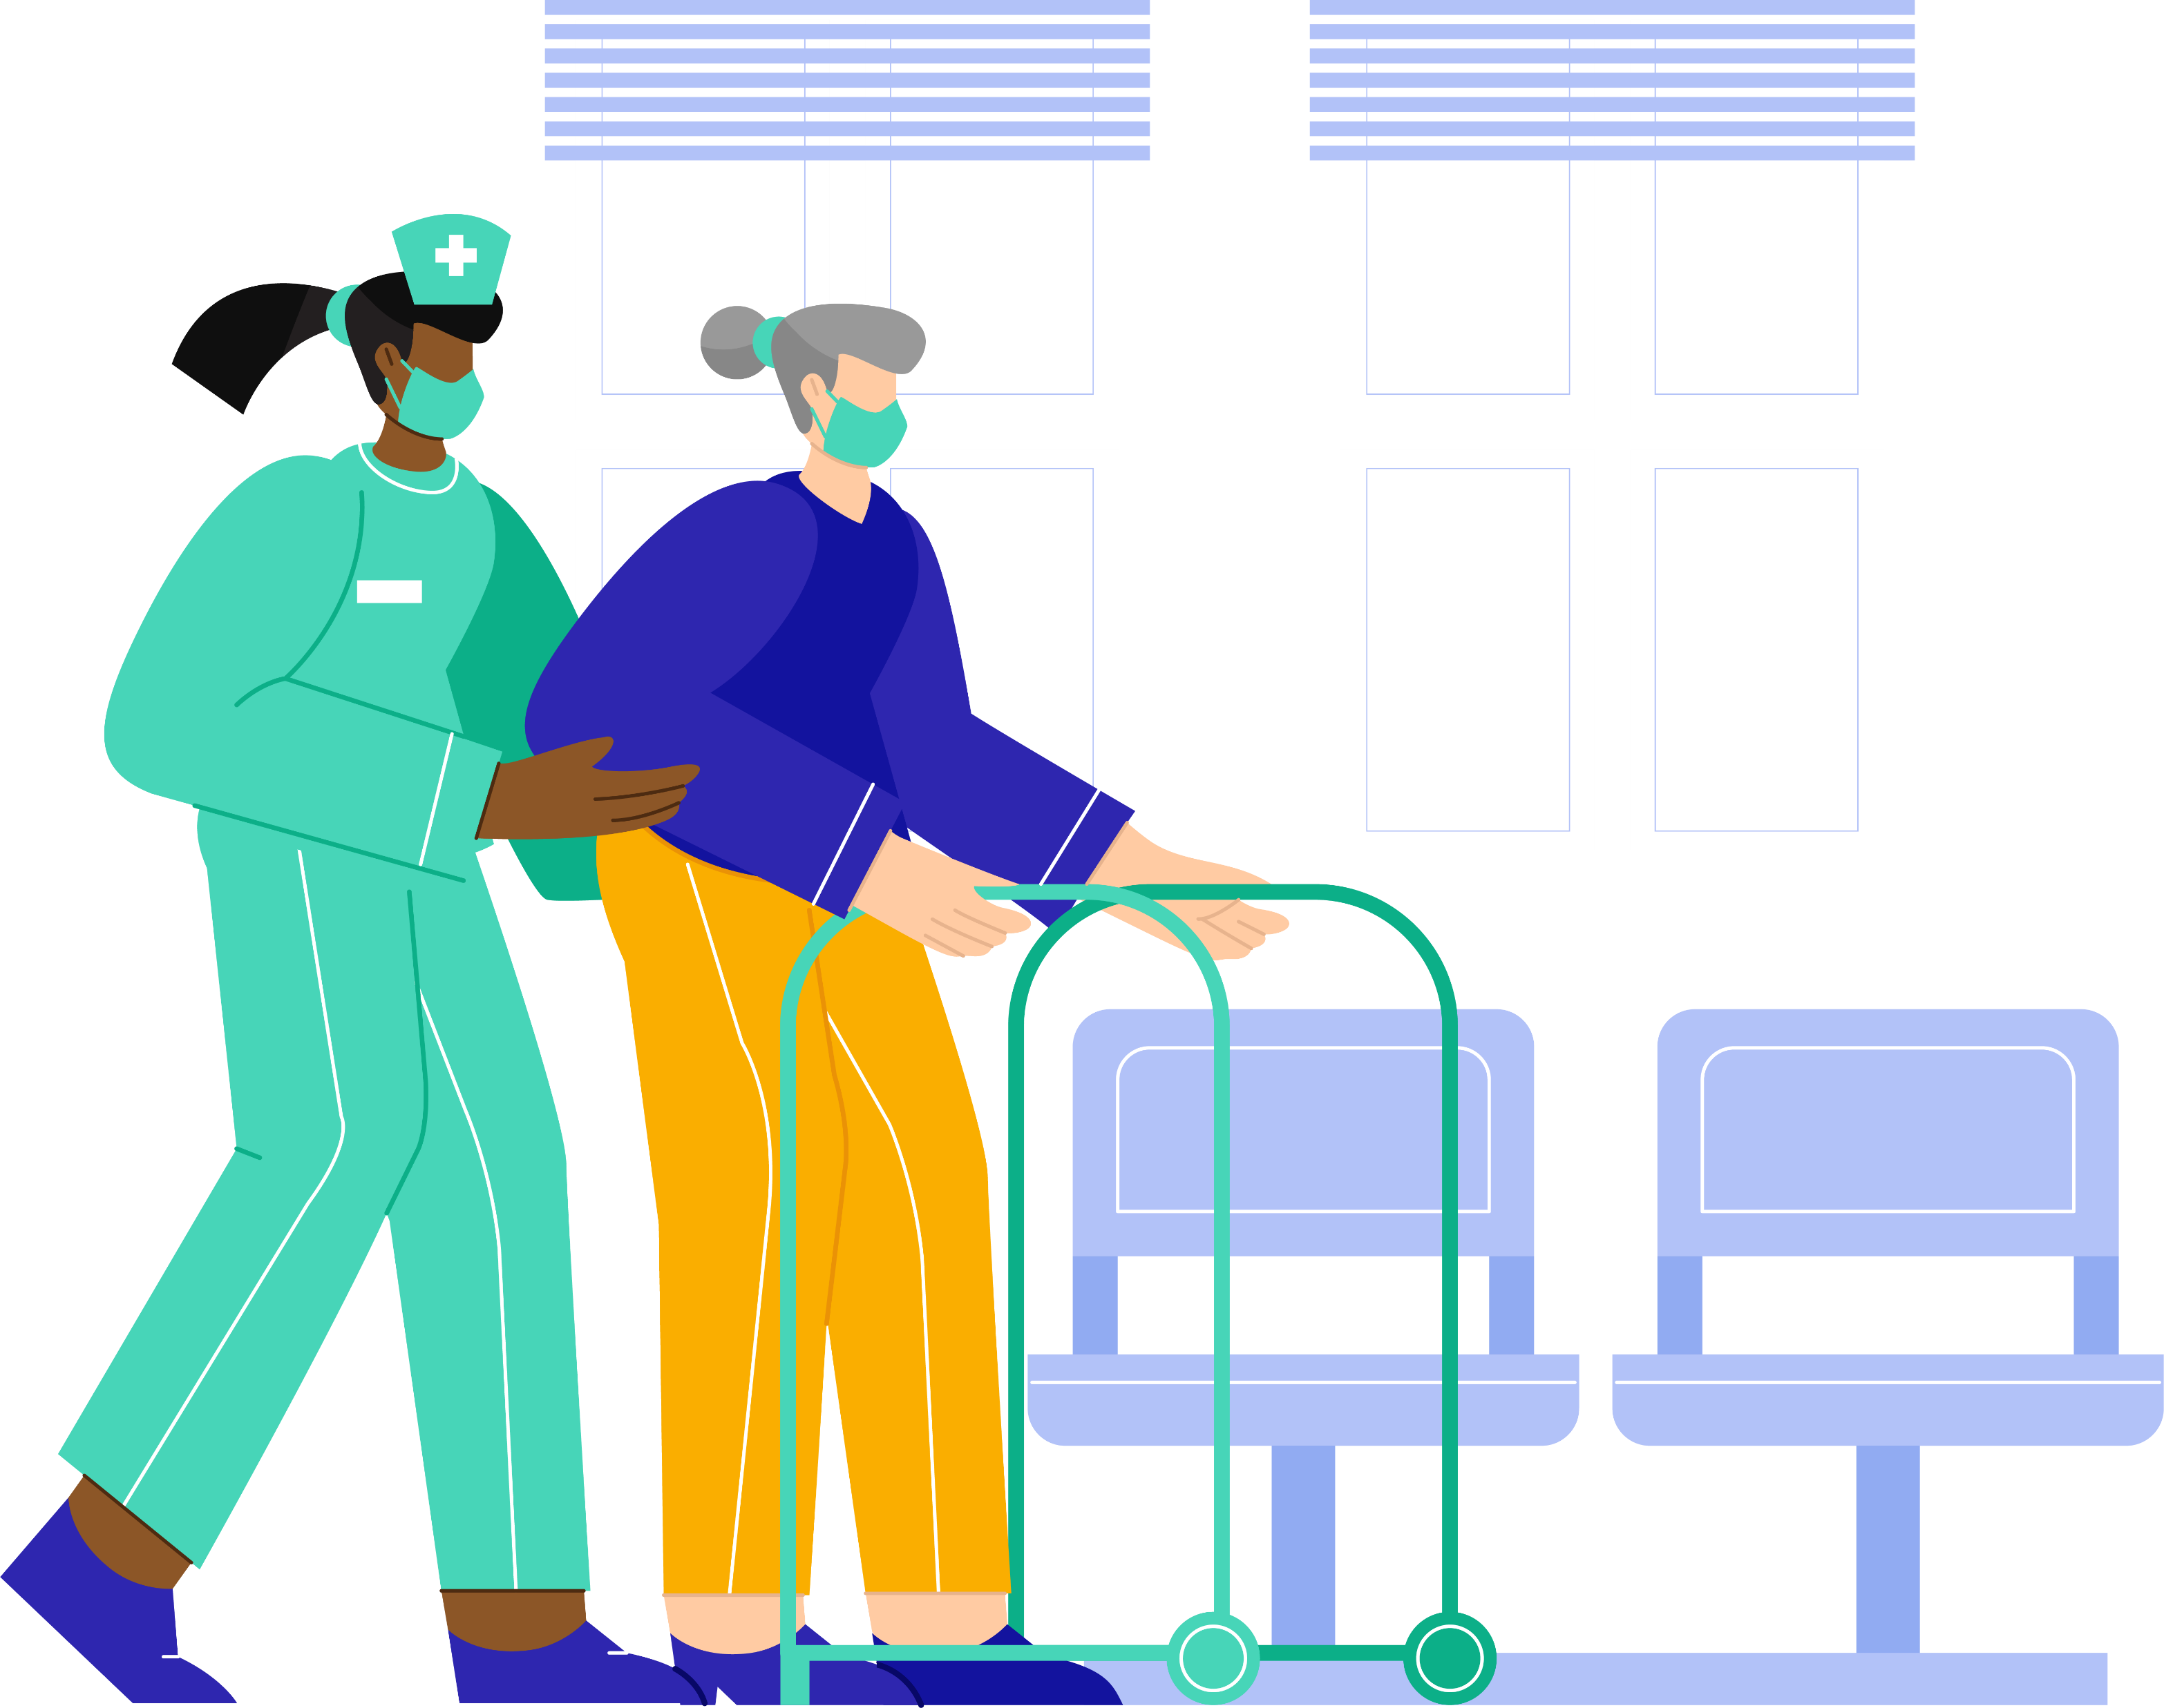
Dignity Alliance
Massachusetts
WHO WE ARE
4
Dignity Alliance Massachusetts (DAM), a grassroots coalition of aging and disability service and advocacy organizations and supporters, works to secure fundamental changes in the provision of long-term services, support, and care.
DAM is dedicated to transformative change to ensure the dignity of older adults, people with disabilities, and their caregivers. We are committed to advancing new ways of providing long-term services, support, living options, and care, while respecting choice and self-determination!

Slide 5
Quote slide
5
“A comprehensive effort is needed to promote
the dignity of all people in the Commonwealth, especially older adults and those with disabilities. Dignity includes the highest possible quality of care and quality of life for all. The eagerness of so many groups to come together this quickly tells us that the time for change is now.”
Arlene Germain, a co-founder of Dignity Alliance and Policy Director of Massachusetts Advocates for Nursing Home Reform

Slide 6
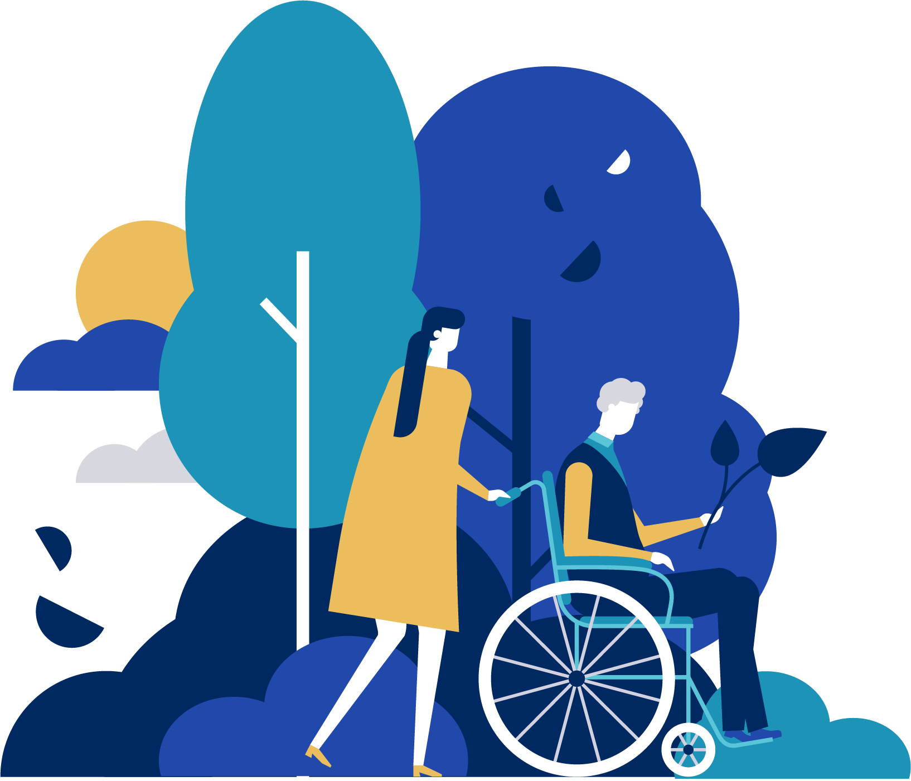
Quote Slide
6
“The nature and function of nursing homes has remained essentially unchanged for the past half century. It is well past time for nursing homes to meet the needs and expectations of adults and persons with disabilities.”
Paul Lanzikos, former Secretary of the Massachusetts Executive Office of Elder Affairs

Slide 7
WHAT DOES DIGNITY LOOK LIKE?
7
RESPECT
SELF-DETERMINATION
CHOICES
Dignity Alliance passionately believes that older adults and persons with disabilities have the right to expect to live their lives in dignity, with self-determination, choices, and with respect to their privacy as much as any other resident. This belief is what drives our coalition.

Slide 8

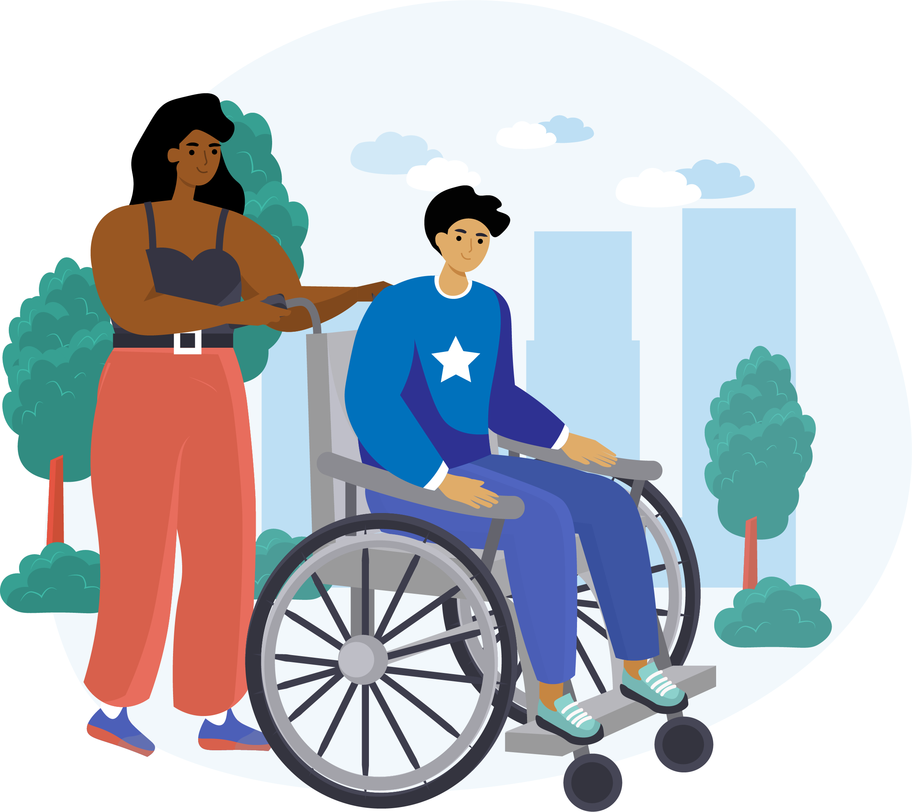
CELEBRATE GLOBAL
DIGNITY DAY!
8
October 20th, 2021
On Global Dignity Day, everyone, everywhere is invited to look beyond what divides us and recognize the dignity and humanity we share.
Check out Global Dignity for events throughout the month of October:
https://globaldignity.org/global-dignity-day

Slide 9




HOW TO CELEBRATE
WITH DIGNITY ALLIANCE
9
@DignityAlliance
Join DAM in celebrating Global Dignity Day on social media Wednesday, October 20th!
DignityAllianceMA
CONTENT IDEAS:
@Dignity_MA
Share what dignity means to you or your organization – or both!
Dignity Alliance
Massachusetts
Provide examples of what dignity does or does not look like, and explain why it is important
Tag us & use the hashtags #DignityUnitesMass and #ThisIsDignity when posting to unite our celebrations!
Express your personal or organizational commitment to dignity
Share ideas or articles about how to honor dignity for older adults and people with disabilities

Slide 10
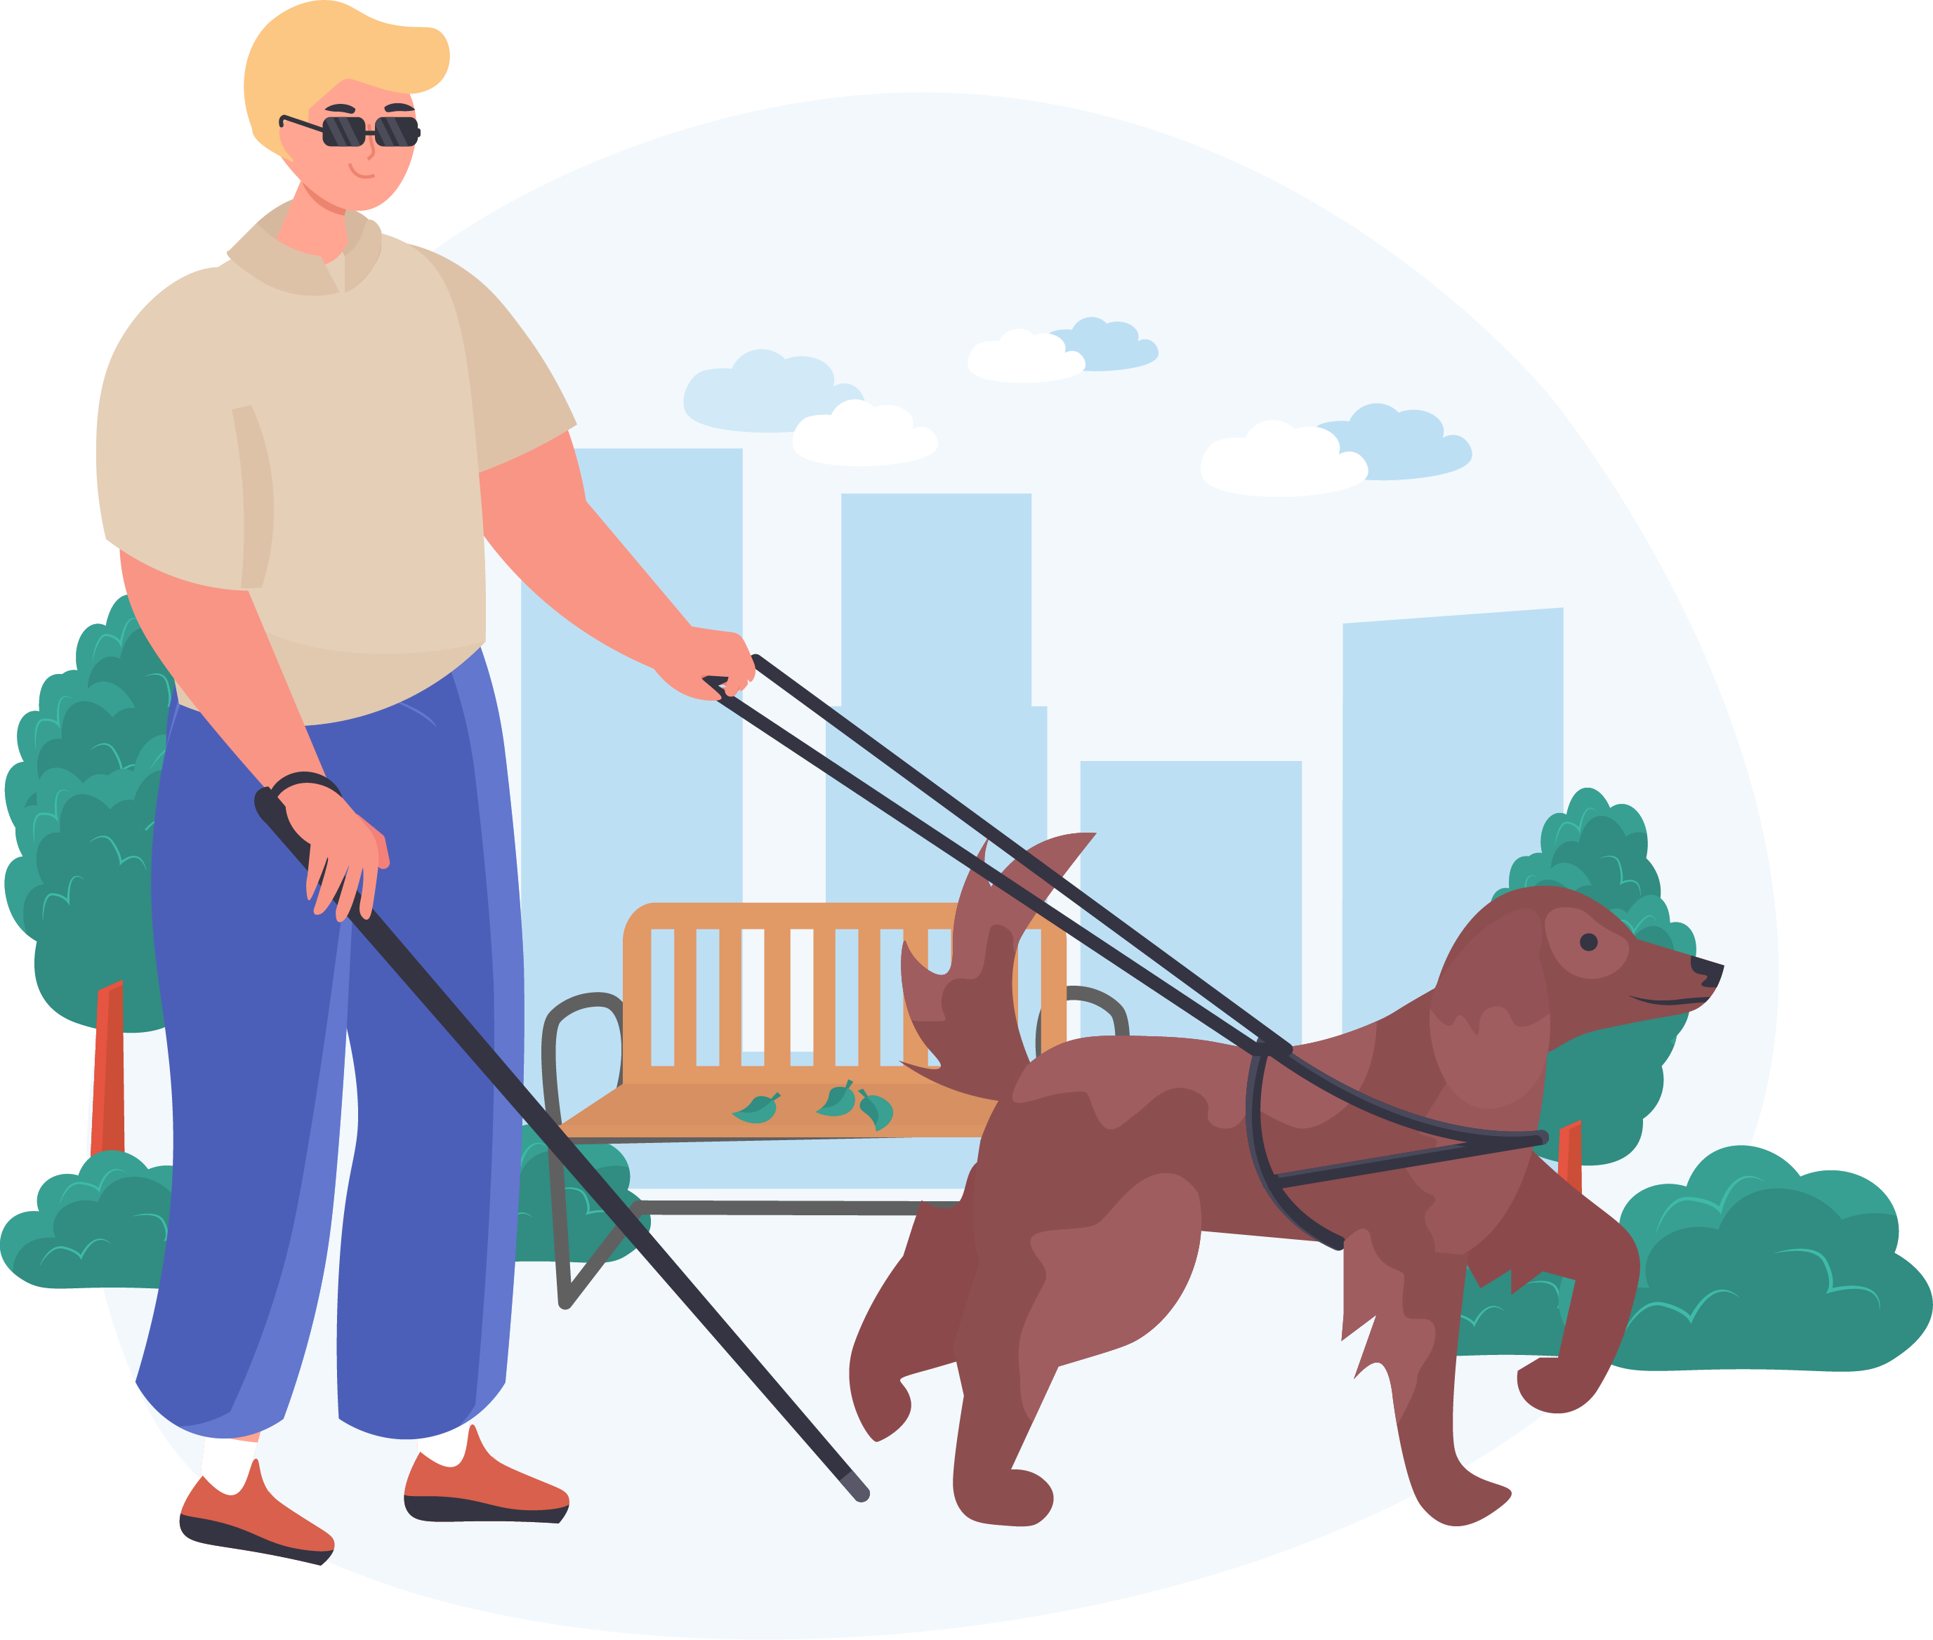
INTERESTED
IN PROMOTING DIGNITY FOR OLDER ADULTS & PEOPLE WITH DISABILTIES?
10

Slide 11
UNITE WITH DIGNITY ALLIANCE
11
DAM is a broad-based group representing a wide range of stakeholders, including nursing home resident advocates, disability rights organizations, legal service entities, mental health organizations, and health policy experts, and centering the voices of older adults and individuals with disabilities.
Our aim is to advance policies that revolutionize long-term care, putting the dignity of individuals first, providing affordable options for community living, and ensuring living wages and benefits for those who work in facilities.
Join the movement to promote dignity for all today at:
https://dignityalliancema.org

