Slide 1







“Your Health Care. Your Choice.”
Inform & empower adults to make a health care plan,
and support care providers to
connect adults to care in their community.

Slide 2

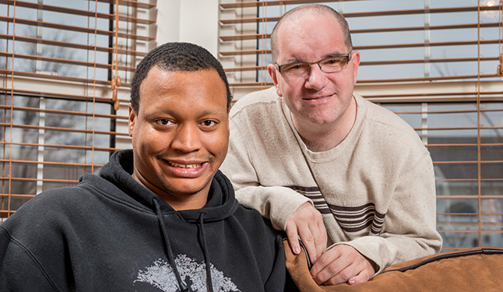

Who’s Your Agent?® Program
A structured, multi-disciplinary approach to health care planning
for adults and care providers. Here are three tool kits anyone can use.
Getting Started Tool Kit
Do it yourself kit to start a simple conversation to make a plan.
Adult & Supportive Person Tool Kit
Adults make a plan choices with the help of a supportive person.
Next Steps Tool Kit
Build on conversations to manage chronic illness and live well with serious illness
MA Health Care Proxy and Personal Directive
Personal Directive and HIPAA
Durable Power of Attorney, MOLST Medical Order
CC/DNR Order

Slide 3



Come Join Us!
11th Annual Health Care Decisions Spring Celebration
March- June. Free planning tools and event ideas!
1. Make You Own Plan- tell others for equal access to free tools
2. Gather Your Group- Co-host a virtual webinar for consumers
3. Support Your Staff- Co-host informational training
2024 March- June Events Calendar
  Have 30 Events POSTED! Expect 60 events.
  Want to co-host a free webinar? Reserve date - first come first serve.
  Contact Ellen, edipaola@honoringchoicesmass.com

Slide 4
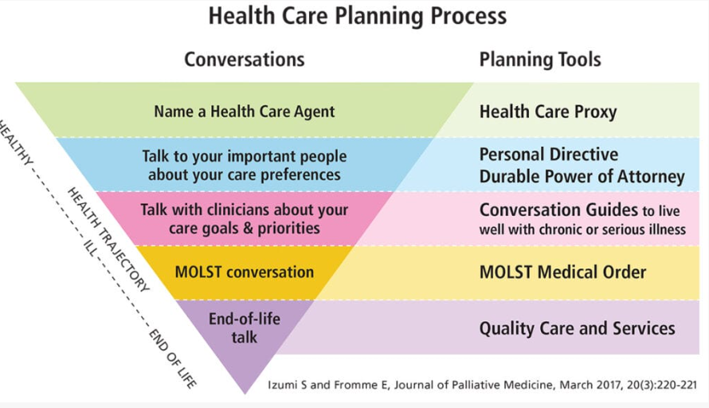
NEW: Health Care Planning Process - Made Simple!
Adults and health care providers can have early, routine and on-going conversations to make a plan for the best possible care today and over the adult’s lifetime.
See Resources webpage at www.honoringchoicesmass.com

Slide 5
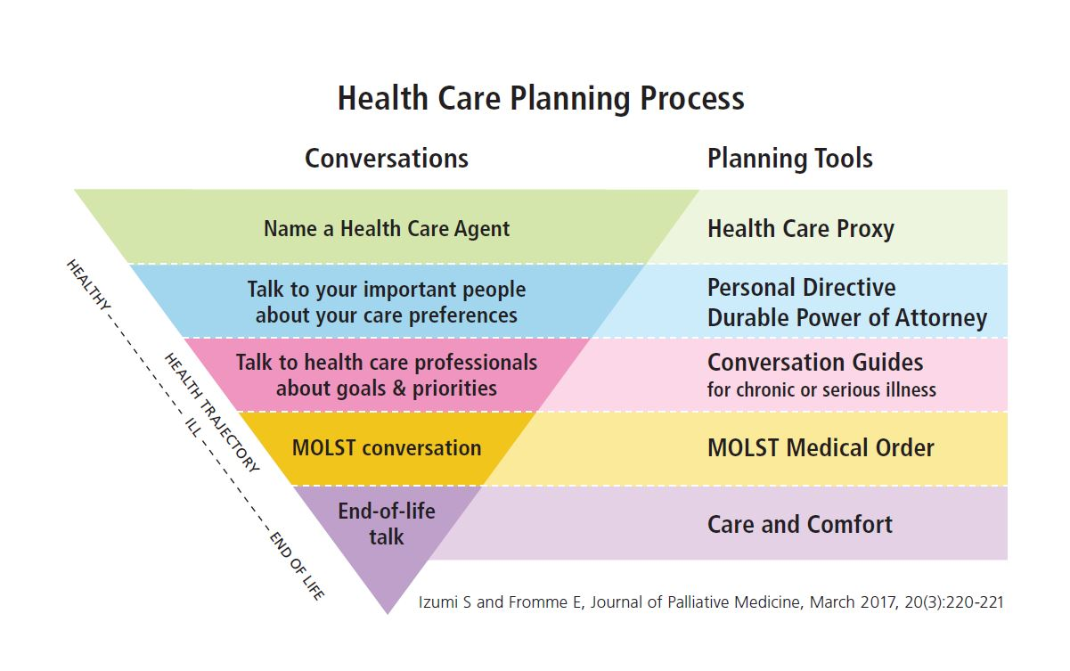
MA Health Care Proxy
  choose a health care decision maker
  document available in 15 languages

Slide 6
MA Personal Directive (Living Will)
  write down your instructions for care
Getting Started Tool Kit- Health Care Proxy and Personal Directive.
Adult & Supportive Person Tool Kit- Personal Directive
MA Durable Power of Attorney
  choose a financial decision maker

Slide 7
Next Steps Tool Kit- build on conversations and add planning documents.
Conversations Guides
  Manage Chronic Illness
    “5 Things to Talk About...” handy conversation guides for both adults and health care professionals.
  Live Well with Serious Illness
    For Adults & Families:
      Palliative Care fact sheet and conversation guide
      What Matters to Me Workbook, Ariadne Labs & The Conversation Project
    For Health Professionals:
      Ariadne Labs Serious Illness Conversation Guide

Slide 8
MOLST, Medical Orders for Life-Sustaining Treatment, fact sheet & sample order
Talk about care and comfort; explore Hospice Care and needed services.

Slide 9
Planning Tools
Getting Started Tool Kit
MA Health Care Proxy- 15 Languages
MA Personal Directive (Living Will)
MA Durable Power of Attorney
Next Steps Tool Kit
Conversations Guides
  HCM “5 Things to Talk About...” for adults & health care professionals;
  For Adults & Families: What Matters to Me Workbook, Ariadne Labs & The Conversation Project
  For Health Providers: Ariadne Labs Serious Illness Conversation Guide
MOLST, Medical Orders for Life-Sustaining Treatment
Hospice Care An End of Life Planning

Slide 10
New: Guardianship, Conservatorship and Alternatives
Guardianship of a person is an important protective intervention, but it also can be the most restrictive.
See Guardianship & Conservatorship webpage.
Before considering guardianship or at ANYTIME during a guardianship:
  assess the adult's decision making ability;
  consider alternative supports and interventions.
New Guardianship & Conservatorship Webpage:
5 Question Checklist: First Consider Less-Restrictive Alternatives
The Guardianship Process: 8 Things to Know
The Conservatorship Process: 5 Things to Know
Resources for All

Slide 11
State Transition from MOLST to POLST
For Official Information see State website www.mass.gov/polst

Slide 12
Upgrading from MOLST to POLST Program
MOLST, Medical Orders for Life Sustaining Treatment to
POLST: Portable Medical Orders for Life- Sustaining Treatment
Know & honor treatment choices of seriously ill and frail individuals
What is POLST Program?
Join National POLST, 45 states
Align with national standards
Build a more inclusive, equitable and responsive program.
Why upgrade now?
MOLST is just a form, not a program
Not updated since 2014
MA EOEA leads the upgrade
POLST Rollout- expected 2025

Slide 13
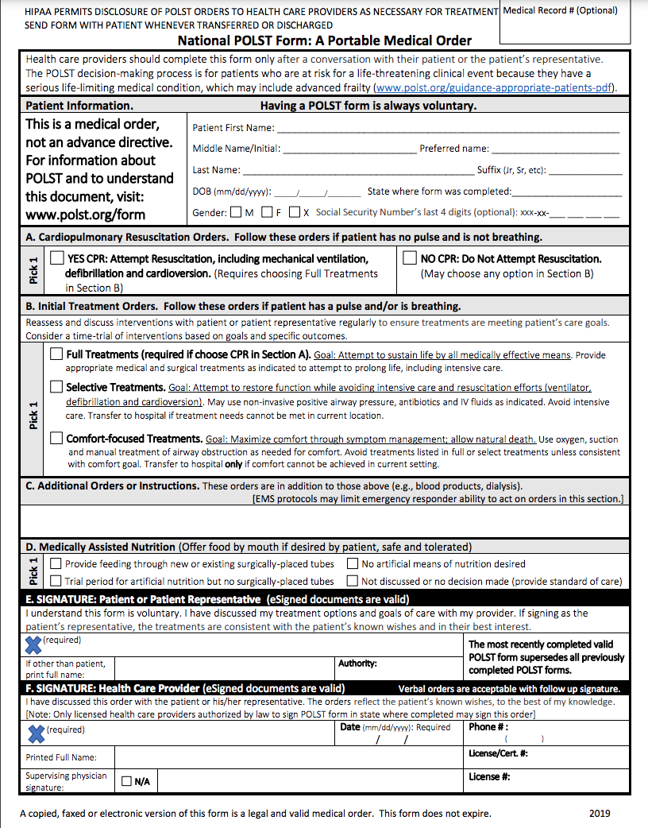

Slide 15
What would help you, your organization and your community?
Here’s what we are hearing from the HCM Partners...
  Health Care Planning is a Process;
    Early and on-going simple to serious conversations with accompanying tools and conversations guides;
  On-line professional training for all interdisciplinary care team members;
  Educate adults & families with free, multi-lingual information;
  Propose and align policy & best practices important for your community, that will be honored across all health, community, Probate & Family court.

Slide 16
POLST Official Program Resources
National POLST website & sample POLST form
  www.polst.org
Priscilla Ross, MA POLST Program Director, MA EOEA
www.mass.gov/polst
MA MOLST to POLST Transition-State Website
  https://www.mass.gov/molst-to-polst-transition
    What organizations need to know:
      Five things you need to know about POLST -Slide Deck
      Fact Sheet about POLST in MA - PDF
      Sign up for Quarterly POLST updates

Slide 17
Come Join Us!
11th Annual Health Care Decisions Spring Celebration
March- June. Free planning tools and event ideas
1. Make You Own Plan- tell others for equal access to free tools
2. Gather Your Group- Co-host a virtual webinar for consumers
3. Support Your Staff- Co-host informational training
2024 March- June Events Calendar
  Have 30 Events POSTED! Expect 60 events.
  Want to co-host a free webinar? Reserve date today- first come first serve.
  Contact Ellen, edipaola@honoringchoicesmass.com

